Slide 1
Chapter 6
Elasticity: The Responsiveness of Demand and Supply
Notes:
Welcome to Economics!
Does this work?

Slide 2
We know that, ceteris paribus, when the price of a good rises:
the Q_{d} of the good ____________.
the Q_{S} of the good ____________
Elasticities allow us to ask “how much”?
Elasticity A measure of how much one economic variable responds to changes in another economic variable.
Ultimately we will examine a variety of elasticities:
Price Elasticity of Demand
Cross-price Elasticity of Demand
Income Elasticity of Demand
Price Elasticity of Supply

Slide 3
The Price Elasticity of Demand and its Measurement
Price
Quantity

Slide 4
The Price Elasticity of Demand and its Measurement
Price elasticity of demand is the responsiveness of the quantity demanded to a change in price.
Notice that this calculation will (almost always) give us a negative number. Why?
Suppose that the price of a good increases by 10% and its quantity demanded falls 20%. What is its price elasticity of demand?

Slide 6

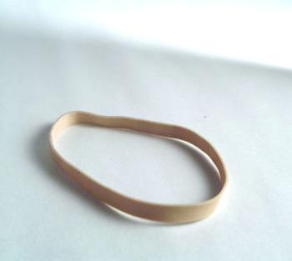
Elasticity of Demand
A demand curve is elastic when an increase in price reduces the quantity demanded a lot (and vice versa).
When the same increase in price reduces quantity demanded just a little, then the demand curve is inelastic.

Slide 7
The Price Elasticity of Demand and its Measurement
Elastic demand Demand is elastic when the percentage change in quantity demanded is greater than the percentage change in price, so the price elasticity is _____________ than 1 in absolute value.
Inelastic demand Demand is inelastic when the percentage change in quantity demanded is less than the percentage change in price, so the price elasticity is __________ than 1 in absolute value.
Unit-elastic demand Demand is unit elastic when the percentage change in quantity demanded is equal to the percentage change in price, so the price elasticity is equal to 1 in absolute value.

Slide 8


Slide 9
The Price Elasticity of Demand and its Measurement
When we calculate the percentage changes in the elasticity calculation, we use the midpoint formula.
e.g. If the price of honey rises from $4 per jar to $6 per jar, what is its percentage increase? We calculate this change using the average of the initial and final prices.
Likewise, if the quantity of honey demanded falls from 100 jars to 60 jars, we calculate the percentage demand using the average of the initial and final quantities.

Slide 10
The Price Elasticity of Demand and its Measurement
Putting it all together, what is the price elasticity of demand for honey in this case?
More generally, here is the equation of the midpoint formula:

Slide 11
The Price Elasticity of Demand
Price
A
B
C
D_{FLAT}
D_{STEEP}
Quantity

Slide 12
What is the elasticity of demand for Google searches?
The summary: Google ran an experiment and observed the following:
Using “time waiting” as the price, calculate Elasticity of Demand for Google searches.
Answer:
-20% / ((0.5/0.65)x100) = -0.26
The page with 10 results took .4 seconds to generate. The page with 30 results took .9 seconds.
Half a second delay caused a 20% drop in traffic. Half a second delay killed user satisfaction.
Notes:
The full text of the post:
In an experiment earlier this year, Google discovered how much people care about how long it takes to perform a search. The company varied the number of search results generated per page from 10 to 30.
The page with 10 results took .4 seconds to generate. The page with 30 results took .9 seconds.
Half a second delay caused a 20% drop in traffic. Half a second delay killed user satisfaction.
What’s interesting about this study is that it gives students an opportunity to calculate the price elasticity of demand for Google searches, using “time waiting” as the price of the search: -20% / ((0.5/0.65)*100) = -0.26 Astute students would note that the actual elasticity is higher than what we calculated since all things are not equal. Getting 30 results per page is more valuable than getting 10.

Slide 13
Polar Cases of Perfectly Elastic and Perfectly Inelastic Demand
Perfectly inelastic demand The case where the quantity demanded is completely unresponsive to price, and the price elasticity of demand equals zero.
P
Q

Slide 14
Polar Cases of Perfectly Elastic and Perfectly Inelastic Demand
Perfectly elastic demand The case where the quantity demanded is infinitely responsive to price, and the price elasticity of demand is infinity.
P
Q

Slide 15


Determinants of Elasticity of Demand
Summary of Determinants of Elasticity of Demand
Less Elastic | More Elastic
Fewer Substitutes | More Substitutes
Short Run (less time) | Long Run (more time)
Necessities | Luxuries
Small Part of Budget | Large Part of Budget
Notes:
Instructor Notes: Table 4.1: Some Factors Determining the Elasticity of Demand

Slide 16
Determinants of Price Elasticity of Demand
Availability of Close Substitutes
The availability of substitutes is important because how consumers react to a change in the price of a product depends on what alternatives they have.
In general, if a product has more substitutes available, it will have ________ elastic demand. If a product has fewer substitutes available, it will have ______ elastic demand.
Passage of Time
It usually takes consumers some time to adjust their buying habits when prices change.
The more time that passes, the _______ elastic the demand for a product becomes.

Slide 17
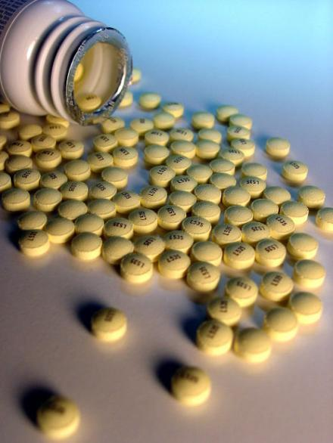
When the patent expires on a brand-name drug and 5 generic drugs come on the market, what happens to elasticity of demand for the brand-name drug?
It rises
It falls
To next
Try it!

Slide 18
Determinants of Price Elasticity of Demand
Luxuries versus Necessities
The demand curve for a luxury is ________ elastic than the demand curve for a necessity.
Share of a Good in a Consumer’s Budget
Goods that take only a small fraction of a consumer’s budget tend to have less elastic demand than goods that take a large fraction.
In general, the demand for a good will be _______ elastic the larger the share of the good in the average consumer’s budget.

Slide 19
Determinants of Price Elasticity of Demand
Definition of the Market
How broadly or narrowly is the market defined?
In a narrowly defined market, consumers have ______ substitutes available.
The more narrowly we define a market, the _____ elastic demand will be.
CEREAL | PRICE ELASTICITY OF DEMAND
Post Raisin Bran
All family breakfast cereals
All types of breakfast cereals

Slide 20
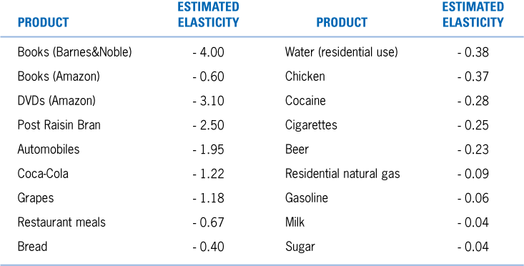
Do the real-world estimated elasticities below make sense to you?

Slide 21
Determinants of Price Elasticity of Demand
Total revenue The total amount of money received by sellers of a good or service, calculated by multiplying price per unit by the number of units sold.
Does total revenue rise if the price of the good rises?
Does total revenue fall if the price of the good falls?

Slide 22
P P
Q Q
Relationship between Price Elasticity of Demand and Total Revenue
D_{Elastic}
D_{Inelastic}

Slide 23
Elasticity of Demand and Total Revenue
Revenues Rise as Price Rises if Demand is Inelastic
P
$20
R=$20x90
=$1,800
$10
R=$10x100
=$1,000
R=$10x100
=$1,000
D
Q
90
100
Notes:
Instructor Notes: Figure 4.2: Elasticity and Revenue Panel A Inelastic Demand
Revenues rise because the decrease in quantity demanded is less than the increase in price.

Slide 24
Elasticity of Demand and Total Revenue
Revenues Fall as Price Rises with Elastic Demand Curves
P
$20
R=$20x50
=$1,000
$10
D
R=$10x250
=$2,500
R=$10x250
=$2,500
Q
50
250
Notes:
Instructor Notes: Figure 4.2: Elasticity and Revenue Panel B Elastic Demand
Revenues fall because the decrease in quantity demanded is less than the increase in price.

Slide 25
The Relationship between Price Elasticity of Demand and Total Revenue
Elasticity and Revenue with a Linear Demand Curve
TABLE 6-3
The Relationship between Price Elasticity and Revenue
IF DEMAND IS . . . | THEN . . . | BECAUSE . . .
elastic | an increase in price reduces revenue | the decrease in quantity demanded is proportionally greater than the increase in price.
elastic | a decrease in price increases revenue | the increase in quantity demanded is proportionally greater than the decrease in price.
inelastic | an increase in price increases revenue | the decrease in quantity demanded is proportionally smaller than the increase in price.
inelastic | a decrease in price reduces revenue | the increase in quantity demanded is proportionally smaller than the decrease in price.
unit-elastic | an increase in price does not affect revenue | the decrease in quantity demanded is proportionally the same as the increase in price.
unit-elastic | a decrease in price does not affect revenue | the increase in quantity demanded is proportionally the same as the decrease in price.

Slide 26
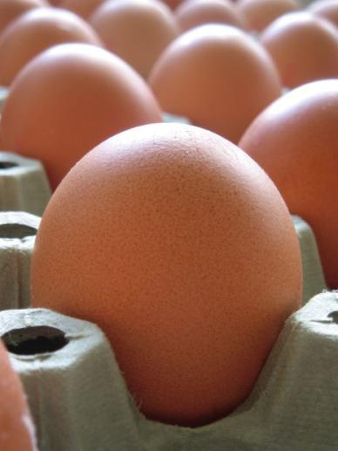
The elasticity of demand for eggs has been estimated to be 0.1. If egg producers raised their prices by 10 percent, what will happen to their total revenue?
It will increase
It will decrease
It won’t change
To next
Try it!
Notes:
Instructor Notes:

Slide 27
If a fashionable clothing store raised its prices by 25 percent, what does that tell you about the store’s estimate of the elasticity of demand for its products?
They think it’s elastic
They think it’s inelastic
To next
Try it!

Slide 28
Application: The “War on Drugs” in the US

Slide 29
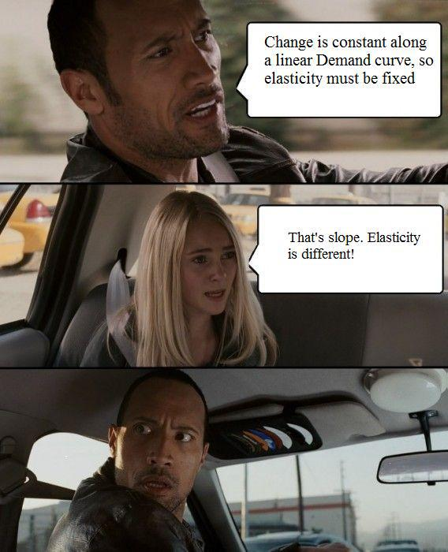

Slide 30
P
Elasticity and Revenue with a Linear Demand Curve
$20
Elasticity varies along a linear demand curve.
At high prices, demand is elastic
At low prices, demand is inelastic.
At the midpoint, demand is unit-elastic
When elasticity varies, then total revenue varies as quantity of output sold changes.
100
Q
P
Total Revenue
100
Q

Slide 31
Other Demand Elasticities
Cross-price elasticity of demand The percentage change in quantity demanded of one good divided by the percentage change in the price of another good.
IF THE PRODUCTS ARE . . . | THEN THE CROSS-PRICE ELASTICITY OF DEMAND WILL BE. … | EXAMPLE
substitutes |  | Two brands of digital music players
complements |  | Digital music players and song downloads from online music stores
unrelated |  | Digital music players and peanut butter

Slide 32
Other Demand Elasticities
Income elasticity of demand A measure of the responsiveness of quantity demanded of a good to changes in income.
IF THE INCOME ELASTICITY OF DEMAND IS . . . | THEN THE GOOD IS . . . | EXAMPLE
positive but less than 1 |  | Bread
positive and greater than 1 |  | Caviar
negative |  | Ramen noodles

Slide 33
Making the Connection
Price Elasticity, Cross-Price Elasticity, and Income Elasticity in the Market for Alcoholic Beverages
Price elasticity of demand for beer | -0.23
Cross-price elasticity of demand between beer and wine | 0.31
Cross-price elasticity of demand between beer and spirits | 0.15
Income elasticity of demand for beer | -0.09
Income elasticity of demand for wine | 5.03
Income elasticity of demand for spirits | 1.21

Slide 34
Applications of Other Demand Elasticities
Suppose that the your company sells a product which has an income elasticity of demand of -0.5. You expect the incomes of buyers to fall by 5% over the next year. What should you expect to happen to the quantity demanded of your product over the next year?
The cross-price elasticity of demand between your company’s product and another company’s product is -1. If the price of the other company’s product rises by 5%, what will happen to the quantity demanded of your product?

Slide 35
The Price Elasticity of Supply and its Measurement
Price elasticity of supply is the responsiveness of the quantity supplied to a change in price.
Note that, due to the law of supply, the price elasticity of supply is (almost always) positive.
Similar to demand, we have the following classifications of price elasticity of supply:
if > 1, then:
if < 1, then:
if = 1, then:

Slide 36
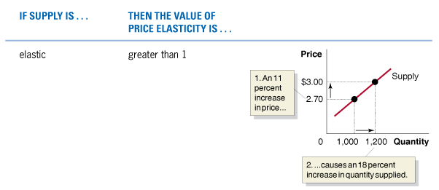
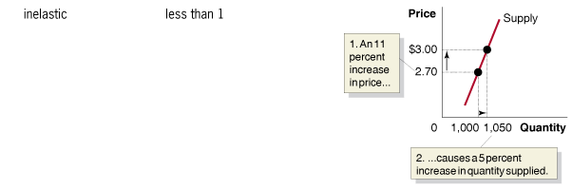
Polar Cases of Perfectly Elastic and Perfectly Inelastic Supply
TABLE 6-6
Summary of the Price Elasticities of Supply
Note: The percentage increases shown in the boxes in the graphs were calculated using the midpoint formula.

Slide 37
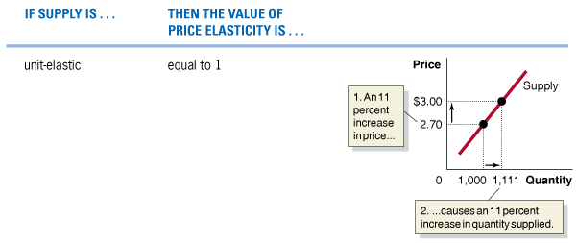
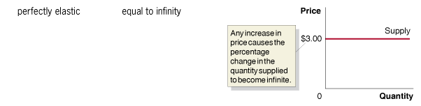
Polar Cases of Perfectly Elastic and Perfectly Inelastic Supply
TABLE 6-6 (continued)
Summary of the Price Elasticities of Supply
Note: The percentage increases shown in the boxes in the graphs were calculated using the midpoint formula.

Slide 38
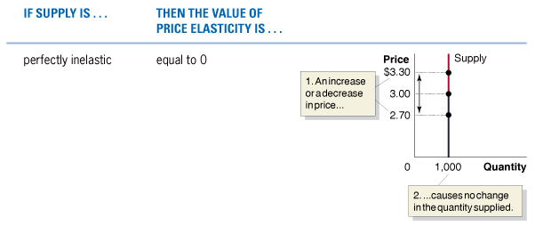
Polar Cases of Perfectly Elastic and Perfectly Inelastic Supply
TABLE 6-6 (continued)
Summary of the Price Elasticities of Supply
Note: The percentage increases shown in the boxes in the graphs were calculated using the midpoint formula.

Slide 39
Determinants of the Price Elasticity of Supply
Whether supply is elastic or inelastic depends on the ability and willingness of firms to alter the quantity they produce as price changes.
Suppose that the price of a product increases.
Often, firms have difficulty increasing the quantity of the product they supply during any short period of time.
On the other hand, if firms find it easy to increase their quantity supplied, then supply is likely to be:
Either way, when you give firms more time to respond to price increases, they are likely to be able to find more ways to increase output.

Slide 40
Application: Changes in Price Depend on the Price Elasticity of Supply
P
S
P
S
D
D
Q
Q

Slide 41
One of the reasons that oil prices are so volatile
Price
S
P₁
D₁
Q₁
Quantity

